Slide 1
OSINT – Collector

Slide 2



Nicola d’Ambrosio
PhD Student @ UniNa manly focused on:
Offensive Security (Automated Exploit Deployment)
Cyber Range (Creation of Vulnerable Environments)
Active Deception Strategies
Threat Modeling and Analysis
GitHub Repository: NS-unina/OSINT-Collector
Notes:
Hi all, I am Nicola d’Ambrosio, a phd student at unina who is focused the generation of vulnerable enviroment, new active deception strategies, threat modelling and analysis and also offensive security which concern the topic that we will address in this talk

Slide 3

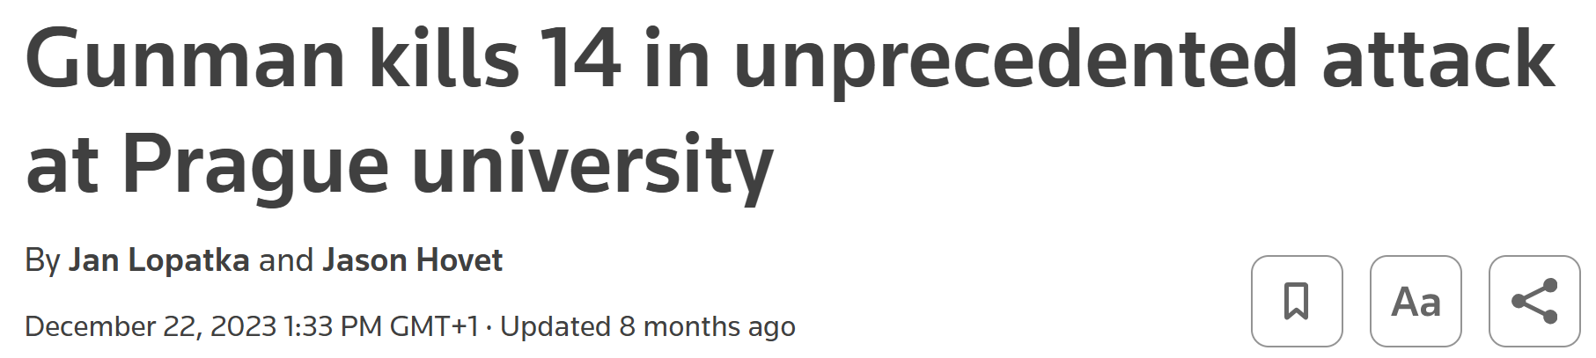
Starting point
Notes:
Before we start, I want to talk about a cruel story where a person decided to kill 14 people in Prague. From this story, I want to highlight how the police started to use social networks to better understand the reasons behind his actions.

Slide 4
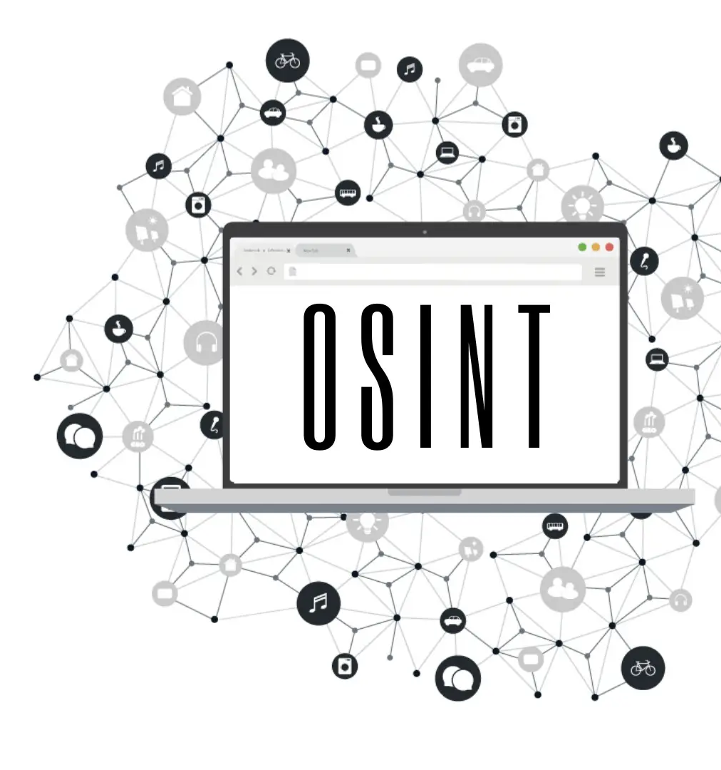
Context
Internet provides vast amounts of data from open sources, such as websites, online forums, and social networks.
This presents both opportunities and challenges, particularly in the realm of Open-Source Intelligence (OSINT), which involves collecting, analyzing, and interpreting publicly available information.
OSINT has become increasingly crucial in various domains, including the Cybersecurity, National Security and Law Enforcement.
Notes:
Open Source Intelligence (OSINT) has started to become increasingly important in investigations. However, many professionals, including judges, lawyers, and others in the legal field, find it challenging to effectively utilize OSINT. The complexity and vastness of digital data can be overwhelming, and there is often a lack of specialized training and understanding of how to properly leverage these tools. This gap highlights the need for more education and resources to help legal professionals integrate OSINT into their practices, ensuring they can fully benefit from the valuable insights it can provide.

Slide 5

Contribution
Development of an advanced framework for the integration and management of OSINT information extracted from social networks.
Development of a user-friendly interface to simplify the collection, organization, and analysis of information.
Integration of advanced algorithms and techniques for data analysis and correlation.

Slide 6
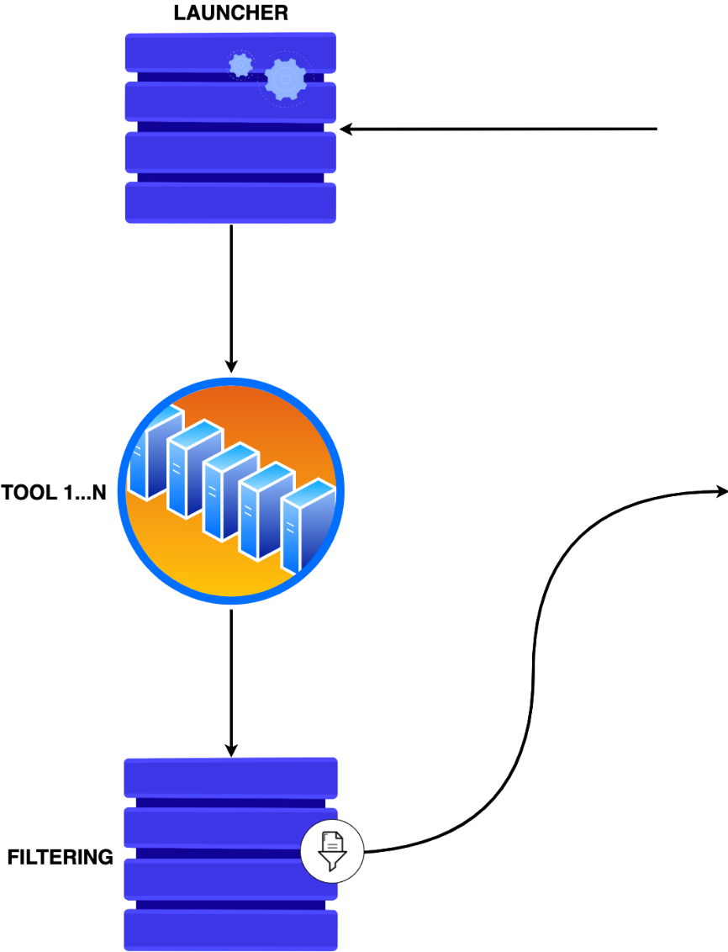
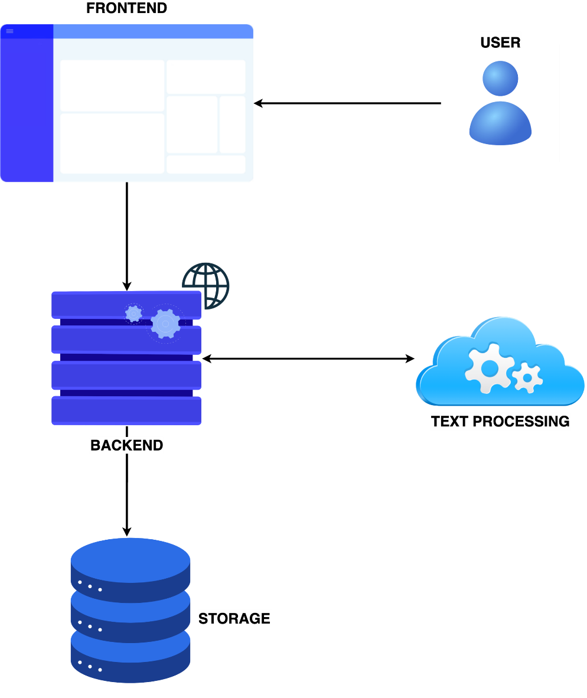
OSINT Collector Framework
Notes:
Aggiungere logo proo

Slide 7
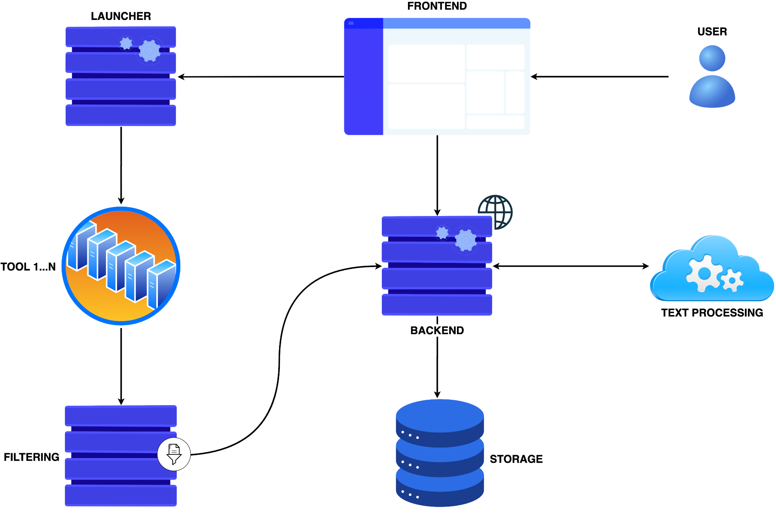

OSINT Collector Framework
Notes:
Aggiungere logo proo

Slide 8
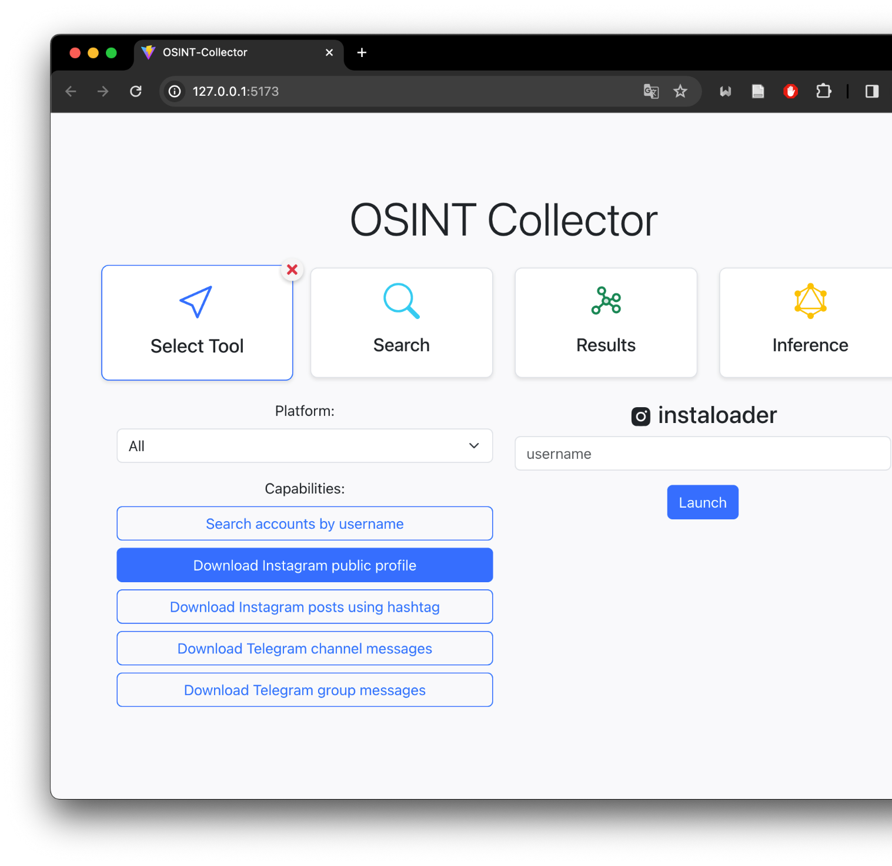
Frontend
The frontend facilitates user interaction with the OSINT framework, allowing for:
Execution of OSINT tools.
Visualization of results.
Analysis of obtained data.
Inferring new information.
Developed using React, the frontend enables users to send requests to the Launcher, responsible for executing selected tools.

Slide 9
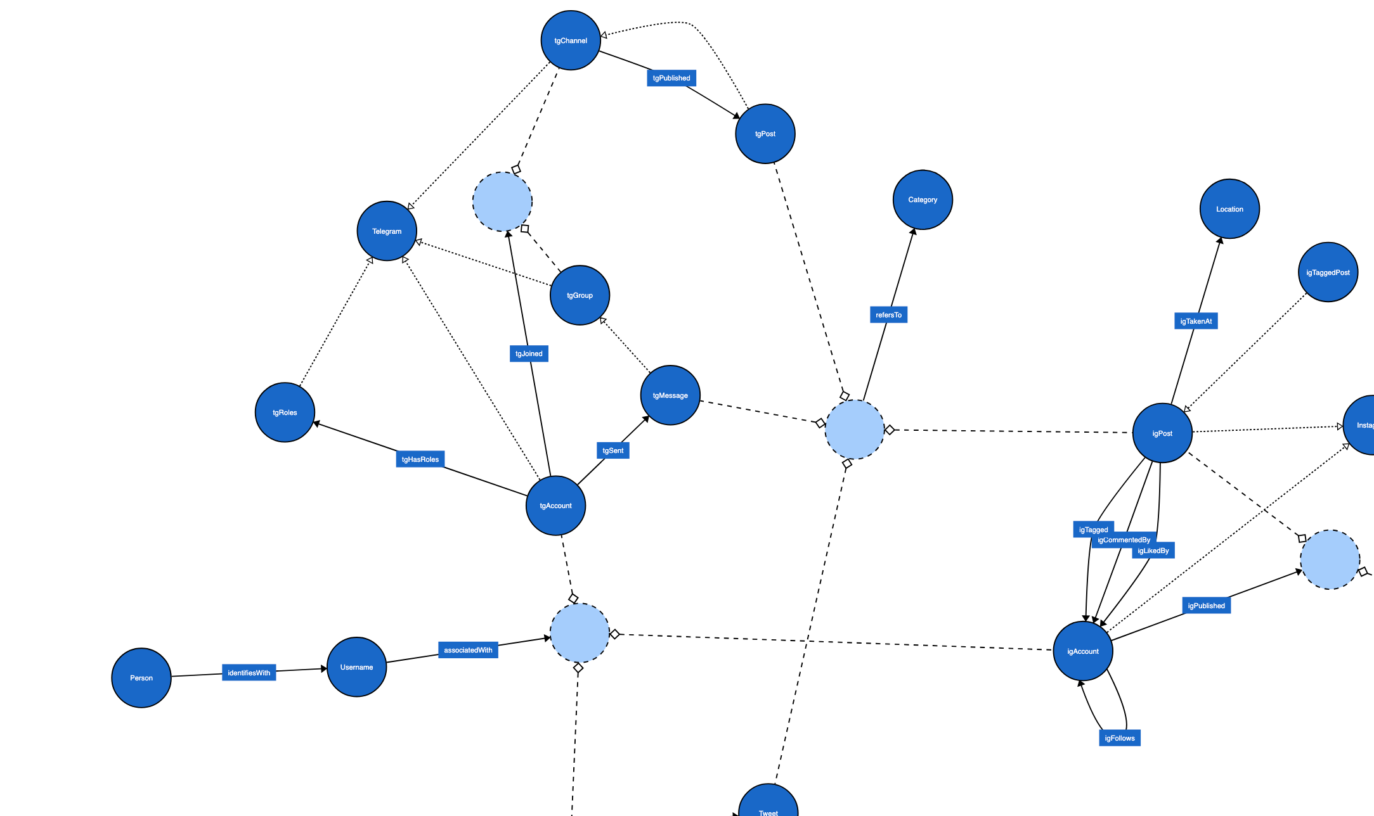
Ontology driven KG construction
To address the heterogeneity of data, we employed an ontology-based approach, which formally describes the entities in a domain and how they relate to each other.

Slide 10
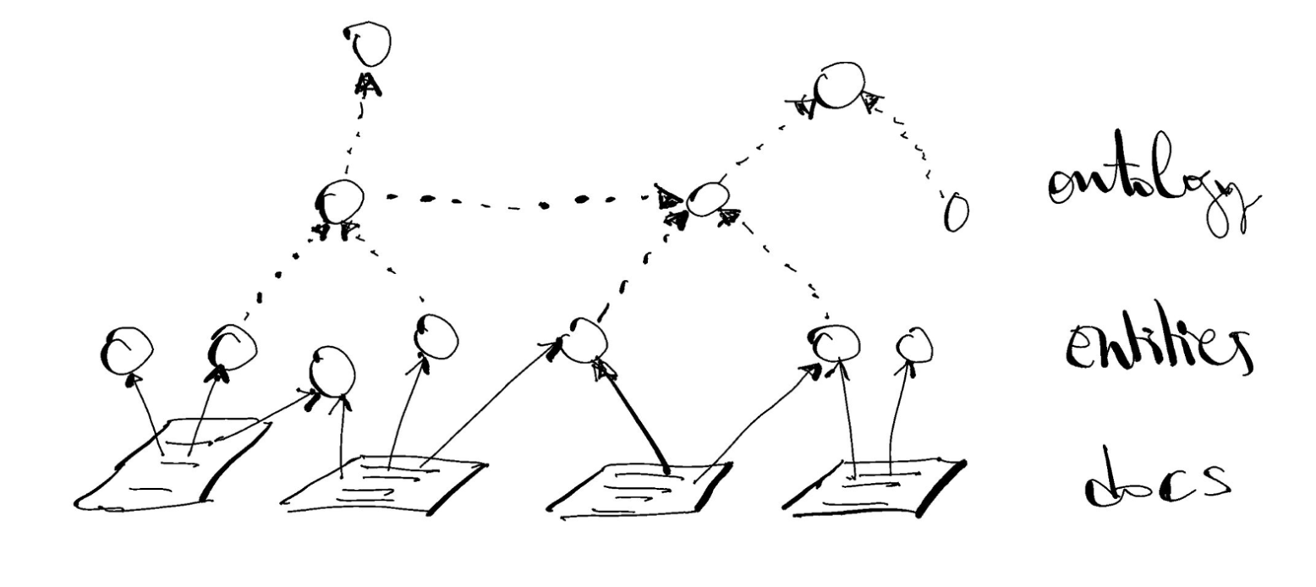
Knowledge Graph and NLP
Enrich the knowledge graph through the analysis and extraction of information from textual documents using Natural Language Processing (NLP) techniques and domain ontologies.

Slide 11
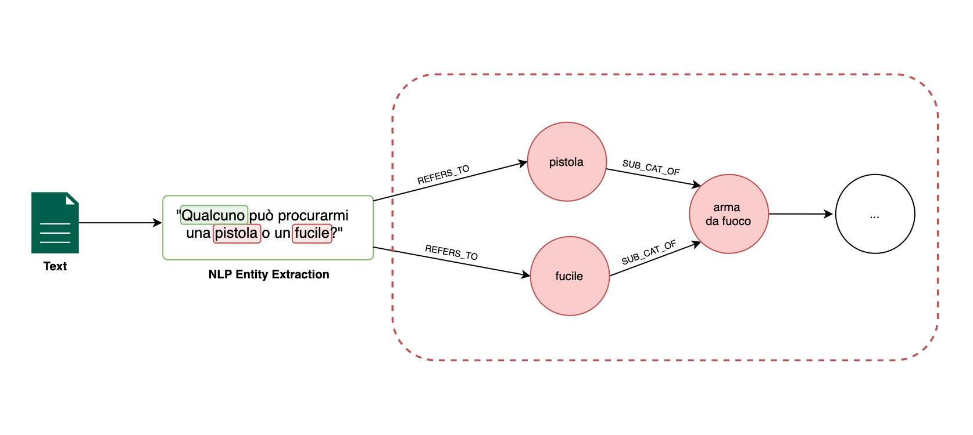
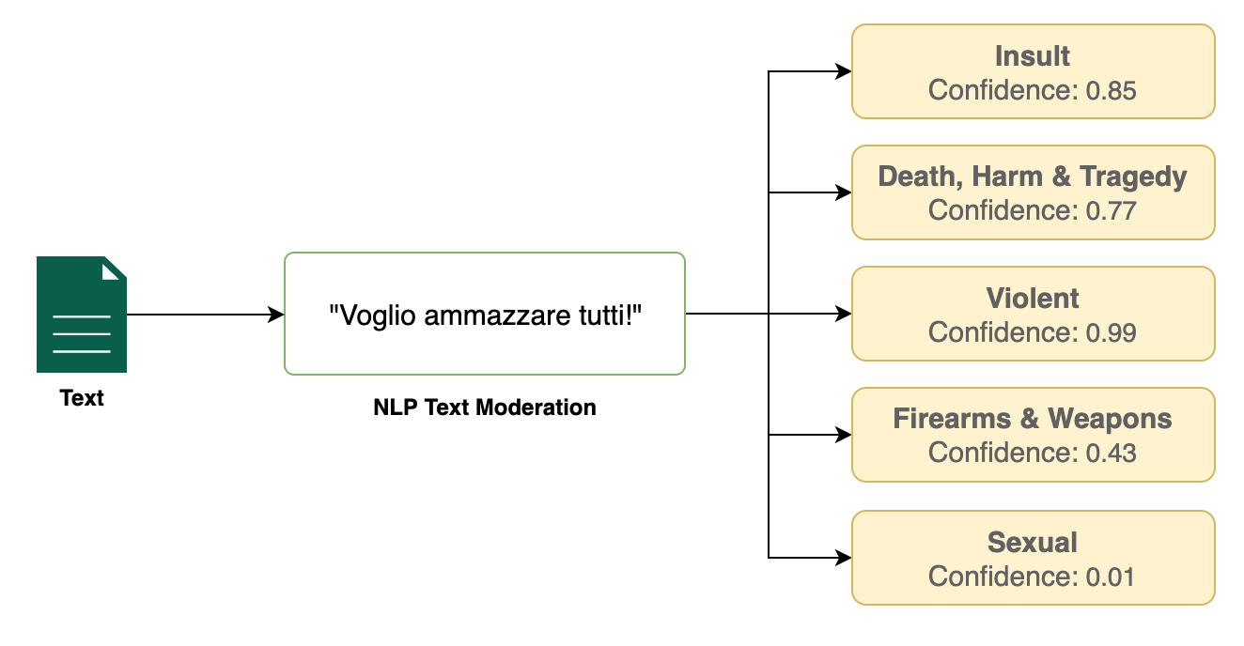
NLP Techniques
1. Entity extraction from text.
2. Text moderation and classification into harmful and sensitive categories.

Slide 12
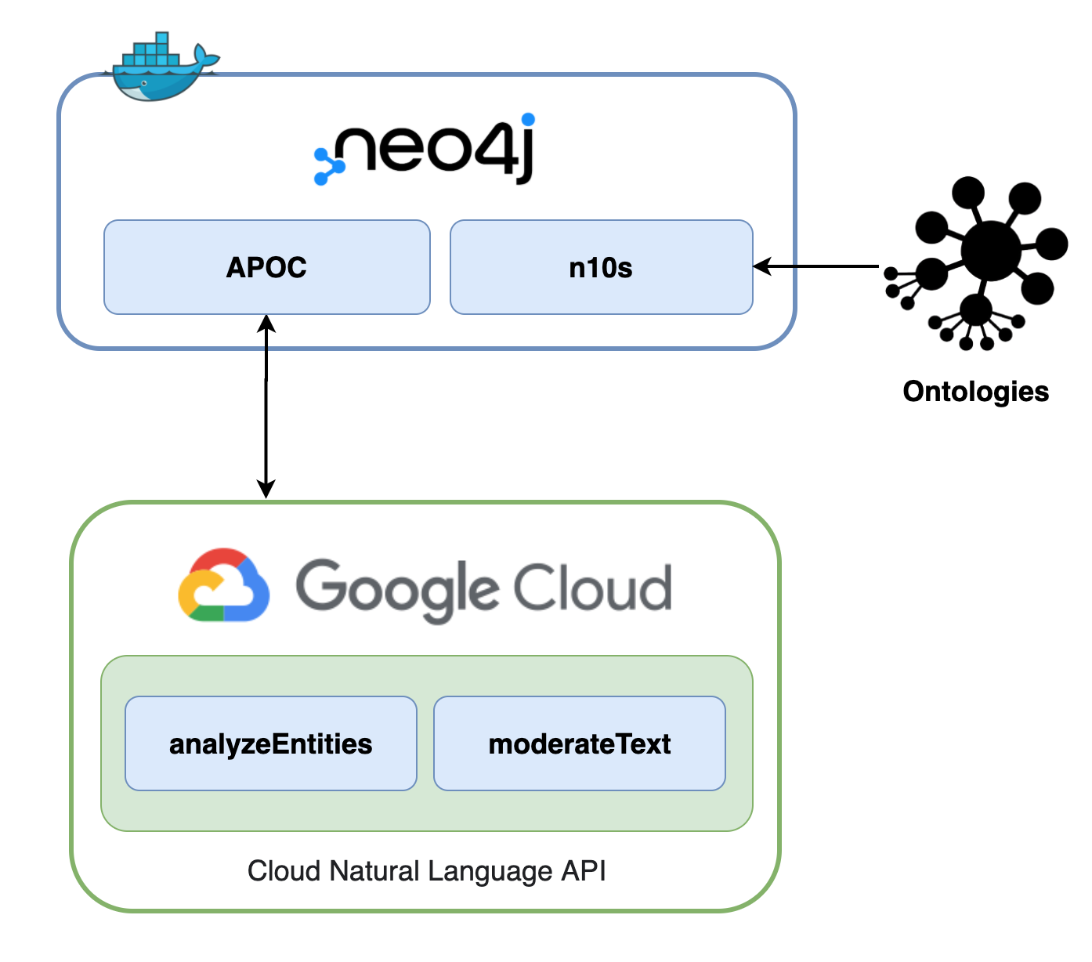
Storage and data analysis
The collected data and the knowledge graph were managed with Neo4j, which allowed us to:
Represent data as nodes and edges.
Perform inferences on the graph.
Manage and expand the ontology.
Utilize Google Cloud APIs for NLP analysis.

Slide 13
Backend
The backend mediates communication between the frontend and the database, ensuring:
A reactive approach for coherence and optimization.
Exposed endpoints for database access and data retrieval.
Utilizing Spring and Spring Data Neo4j, the back-end efficiently manages OSINT data extracted from the launcher.

Slide 14

OSINT Collector Framework
Notes:
Aggiungere logo proo

Slide 15
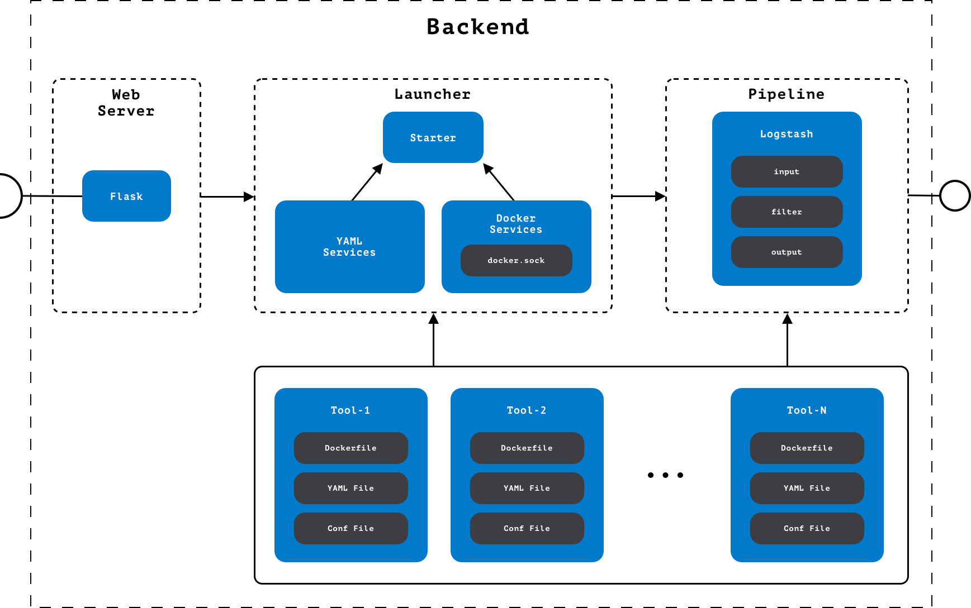
Tool launcher
Notes:
Aggiungere logo proo

Slide 16
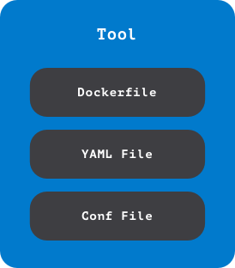
Tool
A tool is an application always executed in a Docker container to control various scenarios. Three configuration files characterize each tool:
Dockerfile: provides the needed instructions to create a Docker container where to launch the tool;
YAML File: defines the tools' behaviors by providing the needed inputs, the capability, and a description;
Conf File: describes what the Logstash pipeline should do to filter data and generate output.

Slide 17
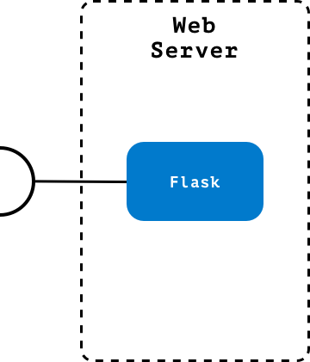
Web Server
The Web Server is in charge of managing requests coming from front-end and addressing them to the launcher; the interface exposed by the Web Server consists of three endpoints:
/tools: retrieves the list of supported tools;
/tools/<tool_name>: provides the details of the requested tool;
/launch: allows the execution of a tool.

Slide 18
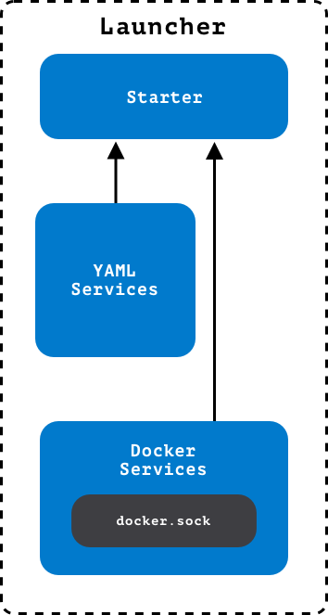
Launcher
The launcher manages the tool life cycle, from the tool execution to output generation. To do that, the launcher uses other submodules for efficient management of the architecture:
Starter: manages the tool startup and lifecycle;
YAML Services: manages the interaction between the launcher and the configuration YAML file;
Docker Services: manages the startup of Docker container for tools and pipeline execution.

Slide 19
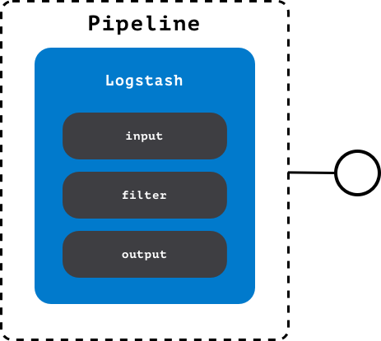
Pipeline
The pipeline is an instance of Logstash that processes data, allows data filtering, and generates output. The Logstash pipeline is managed in three steps:
Input: defines how to take what is generated by the tools;
Filter: defines how to process the data received as input;
Output: defines how to save the data generated by the filter section.

Slide 20
Preventing a school shooting: a demo scenario!
«I introduce myself, my name is David, and I want to carry out a shooting at school and possibly commit suicide...»
With this Telegram message, David Kozak, the perpetrator of the University of Prague shooting in December 2023, expressed his intent to carry out a school shooting and potentially commit suicide. This real-life incident has inspired our demonstration scenario.
This scenario demonstrates how our framework can be used to identify and counter potential similar threats.

Slide 21
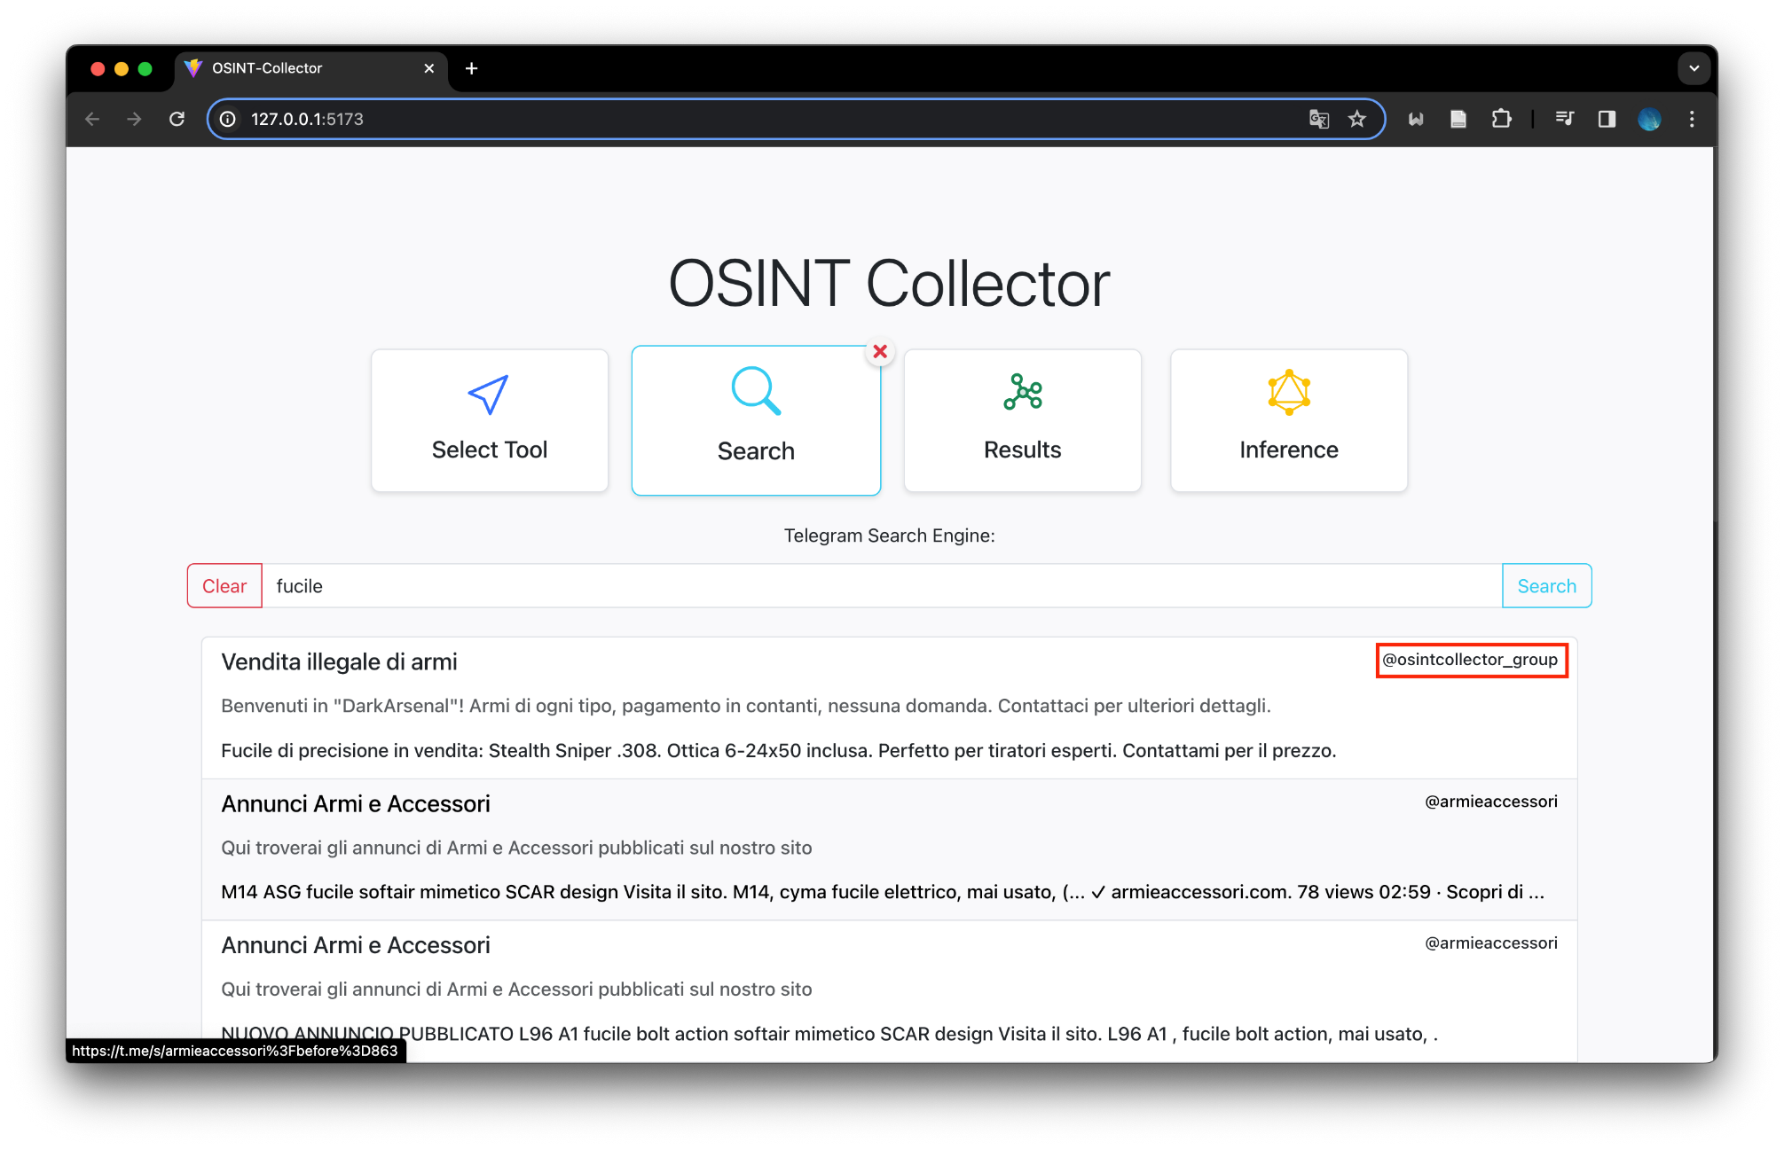
1. Find a suspicious Telegram Group
In our framework, we have integrated a customized search engine to conduct targeted searches for identifying suspicious Groups, Channels, and Accounts on Telegram using keywords.

Slide 22
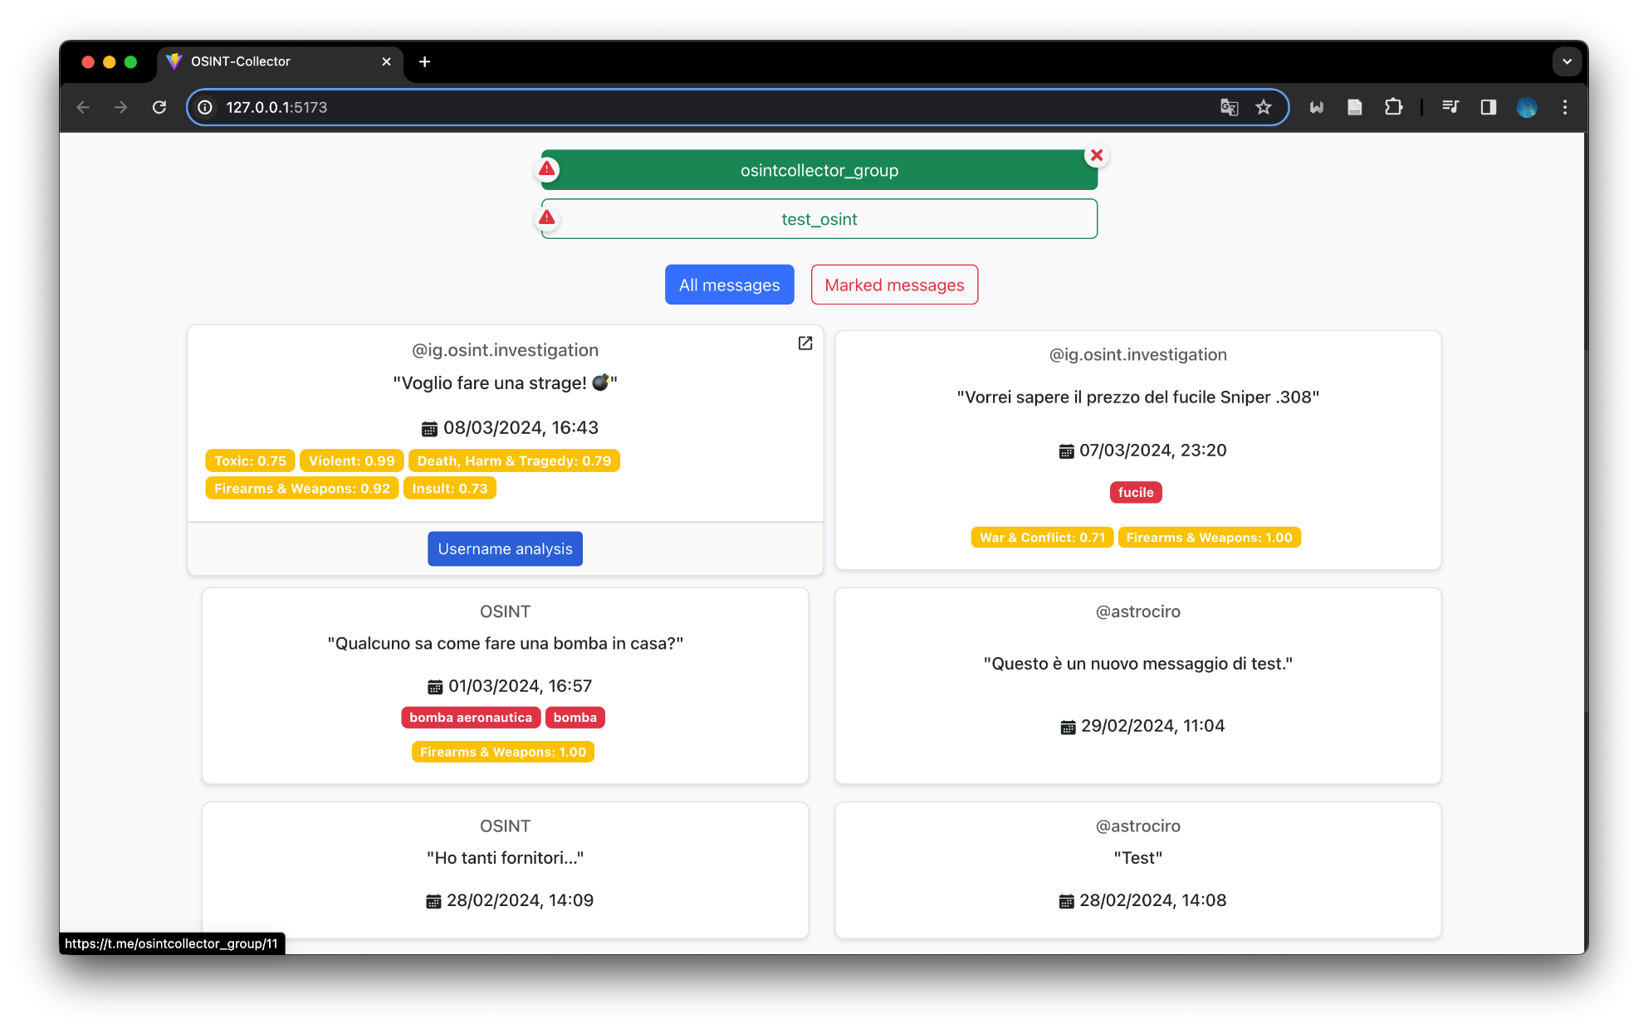
2. Group analysis
Our framework enables the retrieval of all messages sent within a Telegram group, facilitating their analysis to detect any potentially suspicious messages, entities, or categories.

Slide 23
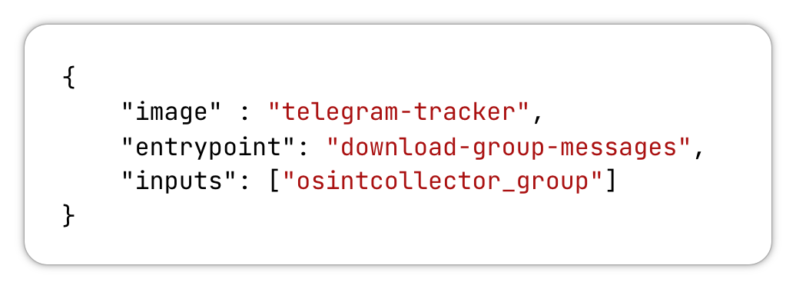
In background
The user can provide a specific telegram group chat that will be sent to the web server as a request body.

Slide 24
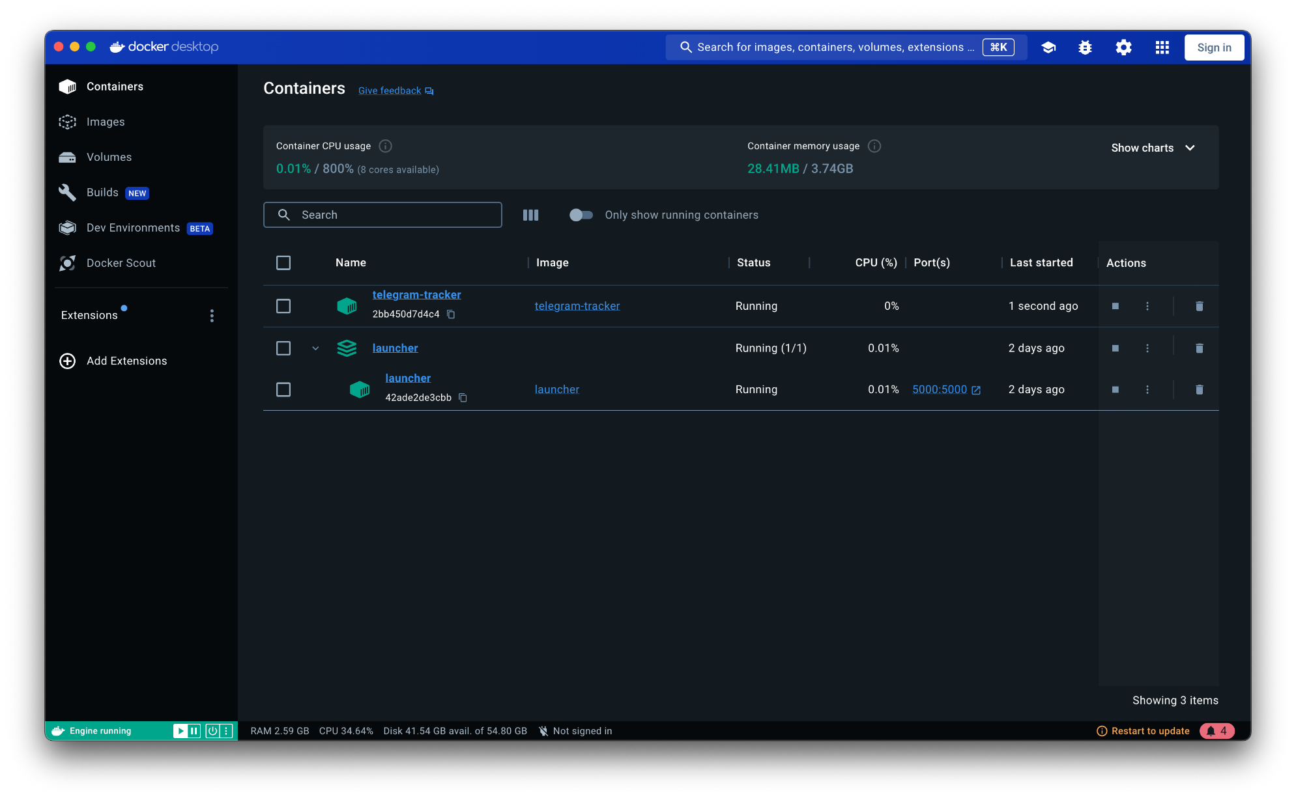
In background - Tool Launch
The launcher will build the image related to the requested tool (telegram-tracker) and run the corresponding container to produce an output file in the corresponding Docker volume.

Slide 25
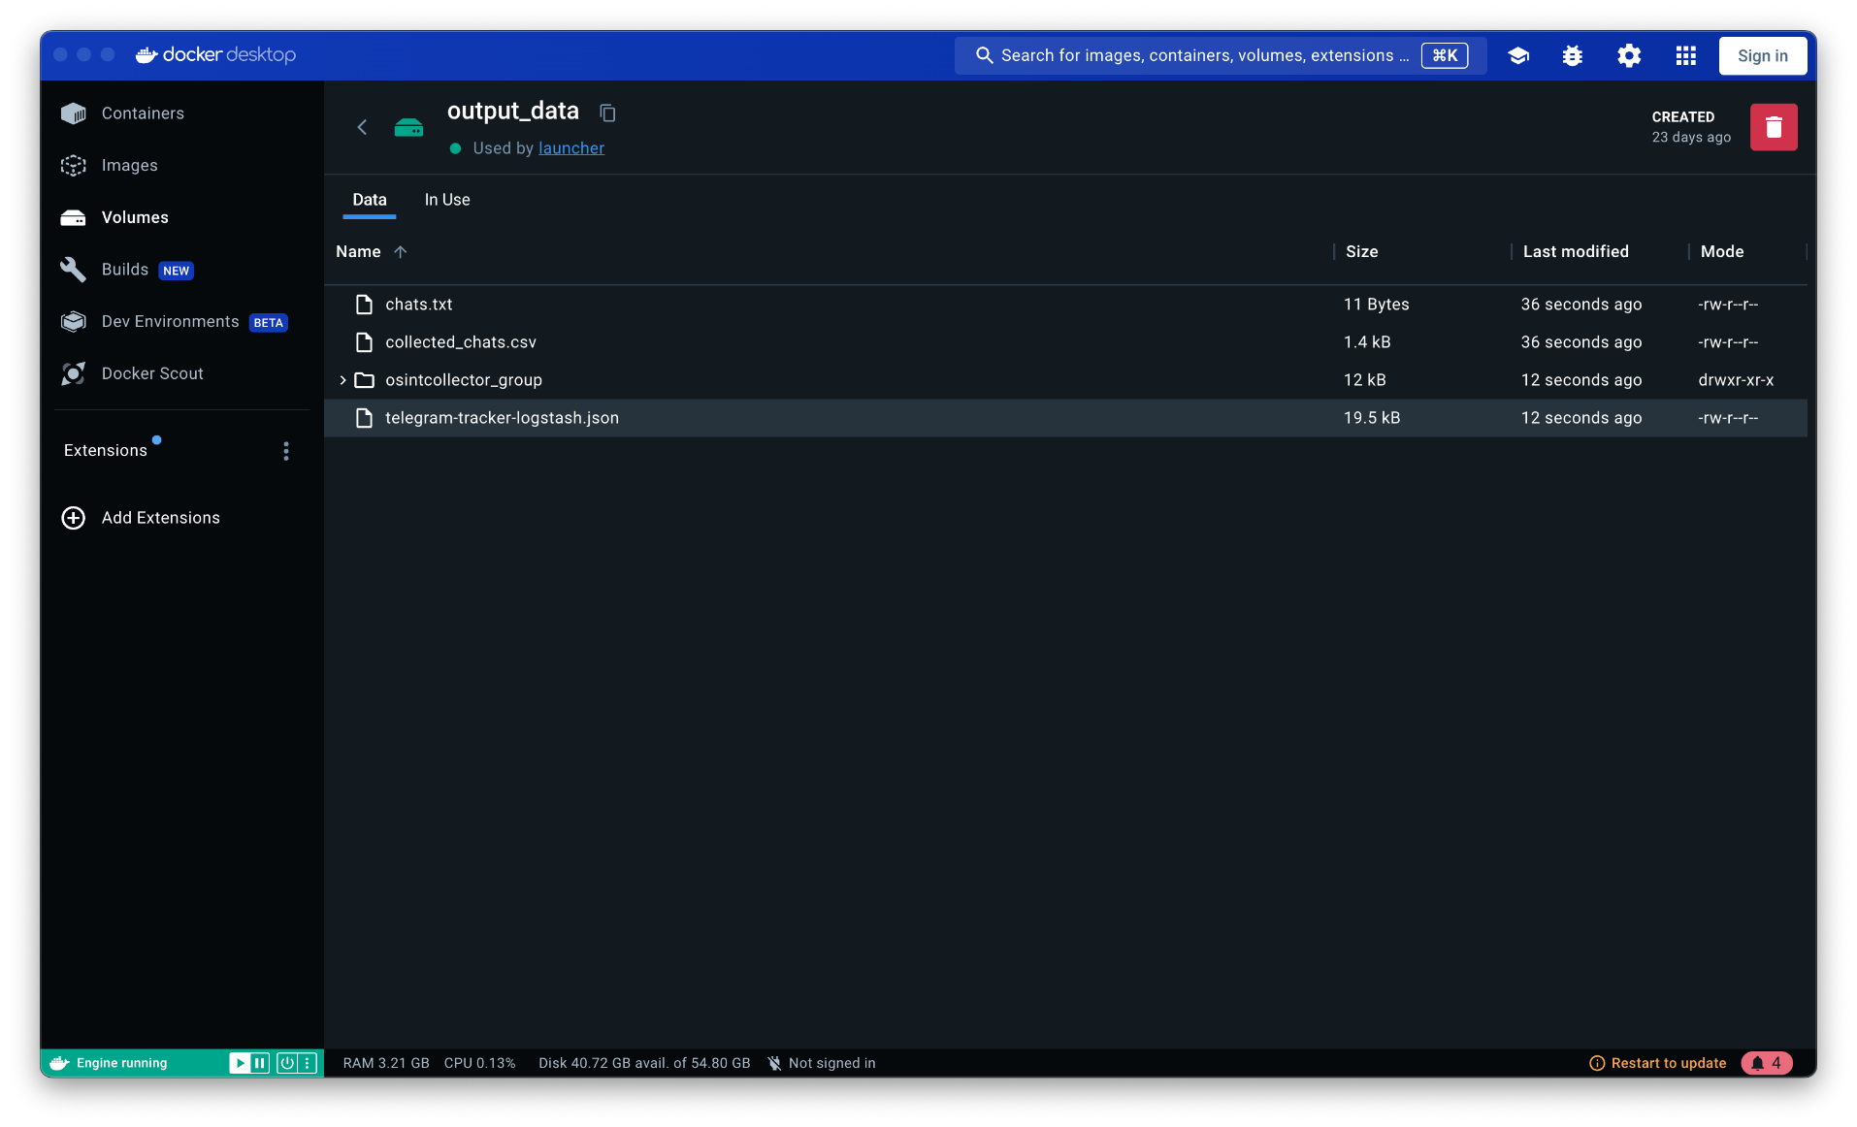
In background - Logstash
The launcher will start the Logstash pipeline, which will take the file containing the data of the messages sent in the provided group chat as an input source and provide a filtered output file.

Slide 26
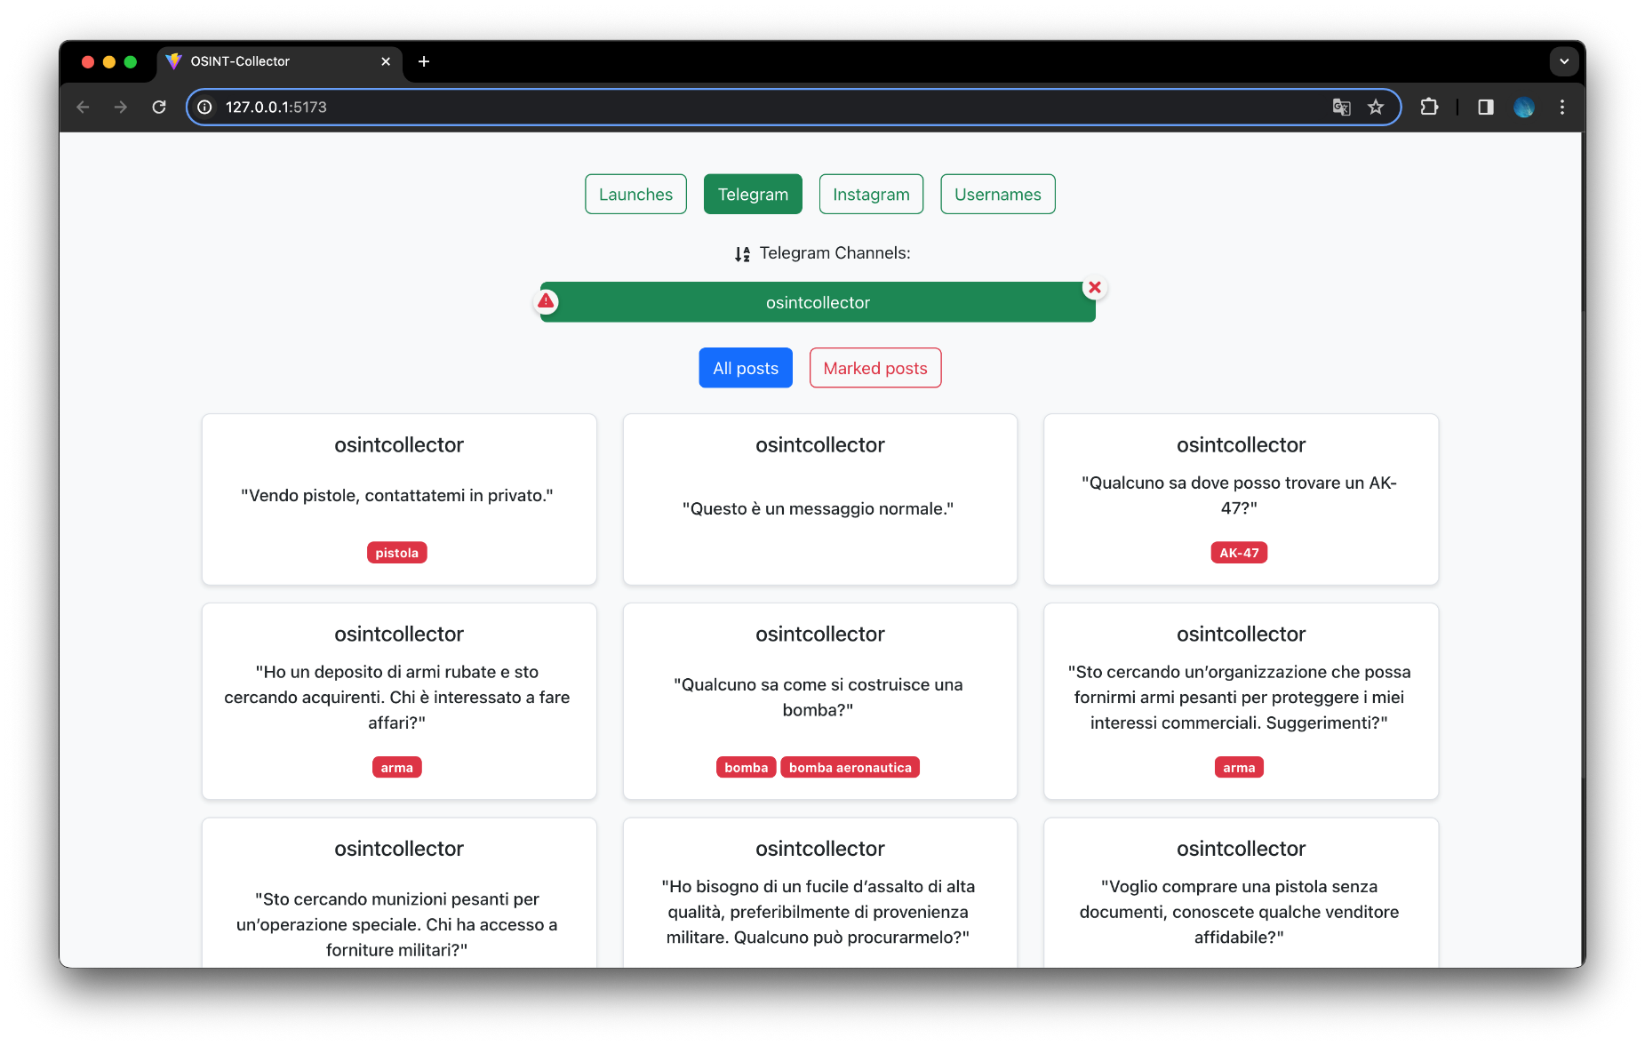
In background - Results Visualization
Logstash's output file will then be sent to the backend, where it will connect the information obtained to a specific domain ontology and display the results.

Slide 27
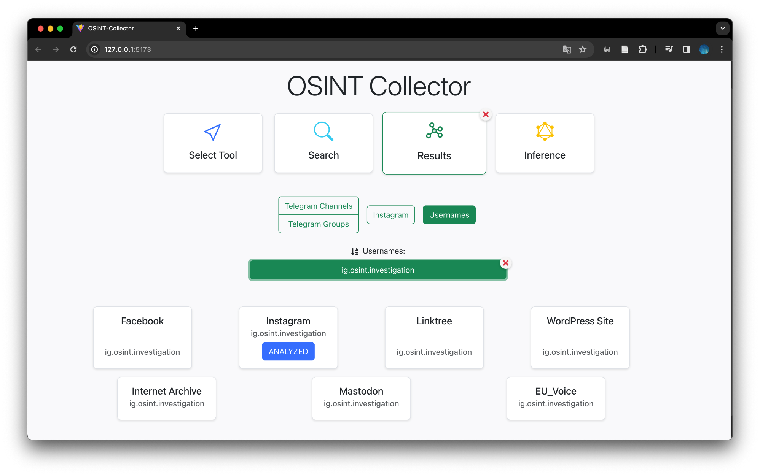
3. Analysis of the suspicious username
Our framework facilitates searching across roughly 500 diverse websites to verify the presence of an account associated with a specific username.
Automatically, if an Instagram account is detected, all related information are retrieved and analyzed.

Slide 28
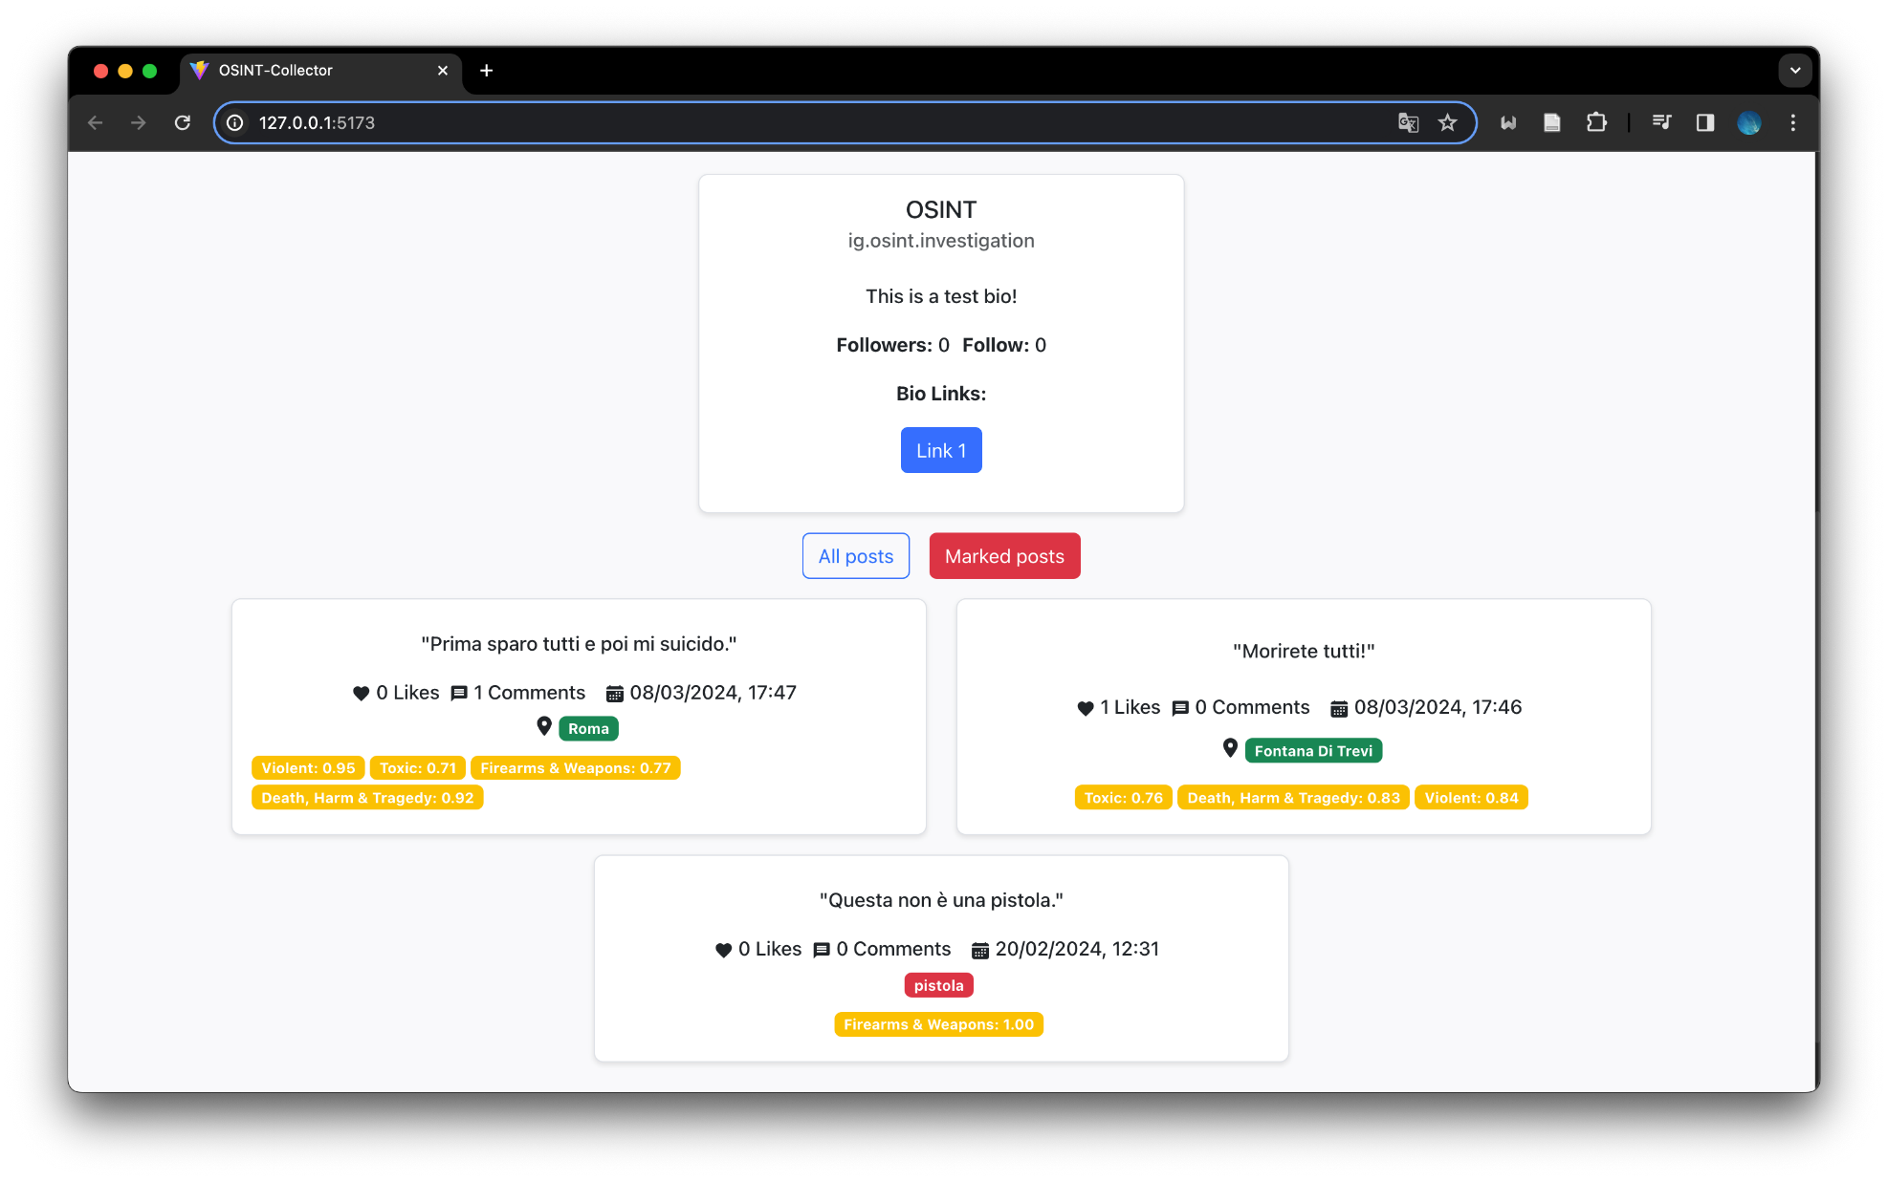
4. Identification of potential terrorist
Finally, we can analyze the data automatically retrieved from the Instagram profile, where our framework has detected posts containing explicit references to violent actions associated with weapons and death.

Slide 29
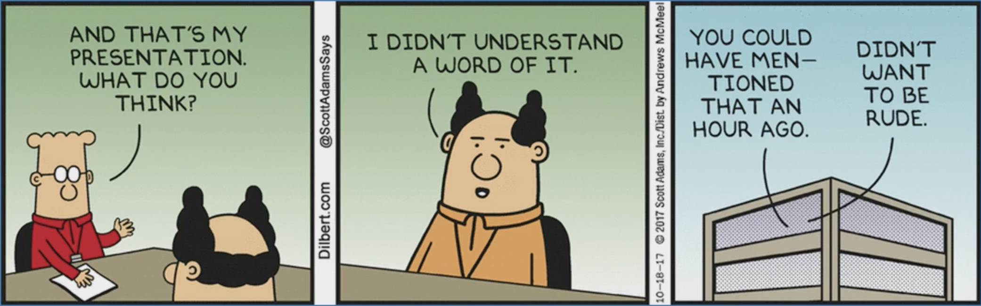

THANKS FOR YOUR ATTENTION!
https://github.com/NS-unina/OSINT-Collector

